Slide 1

REDUCTION OF POWER AND DELAY IN SHIFT REGISTER BY USING MTCMOS TECHNIQUES
BACHELOR OF TECHNOLOGY
IN
ELECTRONICS AND COMMUNICATION ENGINEERING
Presented by:
G.DEVI 19811A0419
K.SAI SREE 19811A0423
M.HEMALATHA 19811A0430
S.POORNA CHANDRA SEKHAR 19811A0443
Under the esteemed guidance of
Mr.T.Pattalu Naidu M.Tech.,(Ph.D)
Assistant Professor

Slide 2
Contents
IFGNFGNGHDF
Introduction
Existing D-Flipflop
Shift register
Proposed Methodology
MTCMOS Technique
Software used
Schematic Diagrams
Conclusion
Future Work

Slide 3
Introduction
Shift registers are a kind of logical logic circuit, primarily for storing digital information.
They’re a gaggle of chain slipper in order that the flip-flop output becomes subsequent flip-flop entry.
All scales are controlled by a standard watch, and are adjusted or reset at identical time.
The log storage capability is that the total range of bits one or zero. Every section (flip-flop) within the shift record represents one a part of the storage capability.

Slide 4
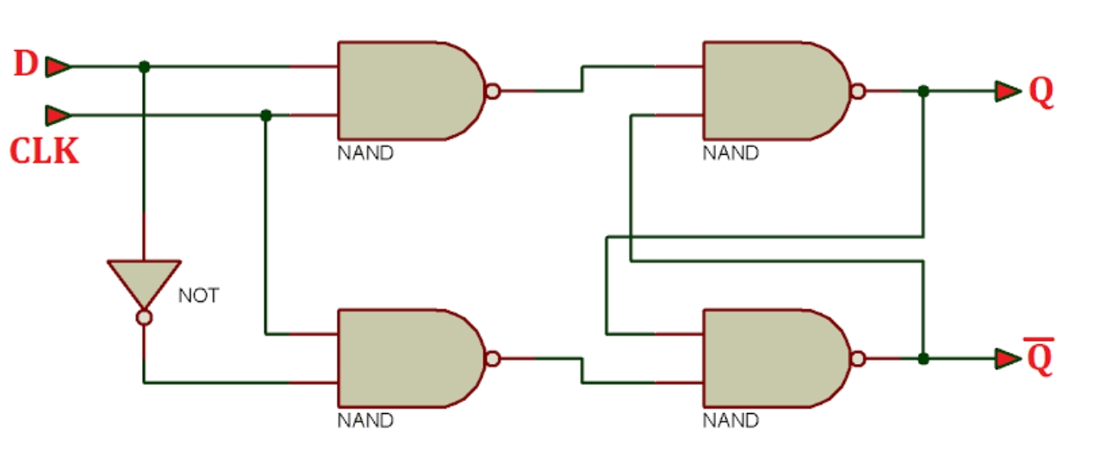
Existing D-Flipflop structure
D-Flipflop using two-input NAND gates.

Slide 5
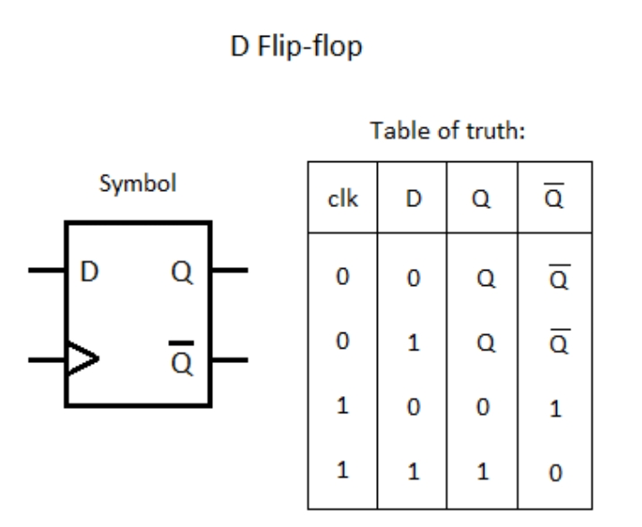

Slide 6
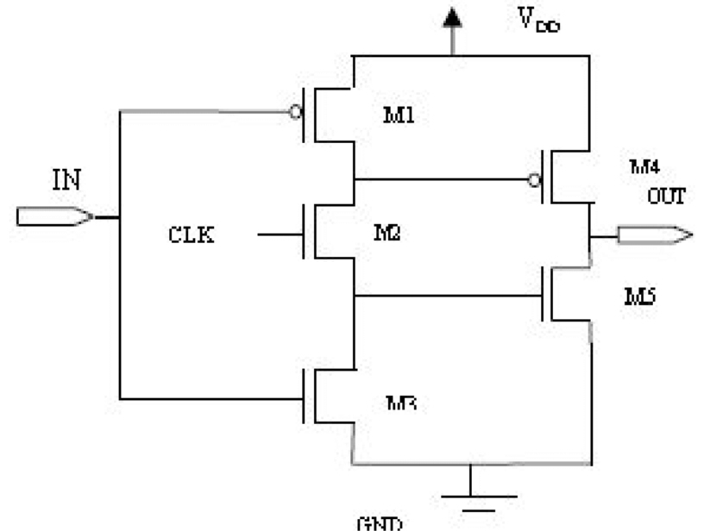
5 Transistor D Flip-flop

Slide 7
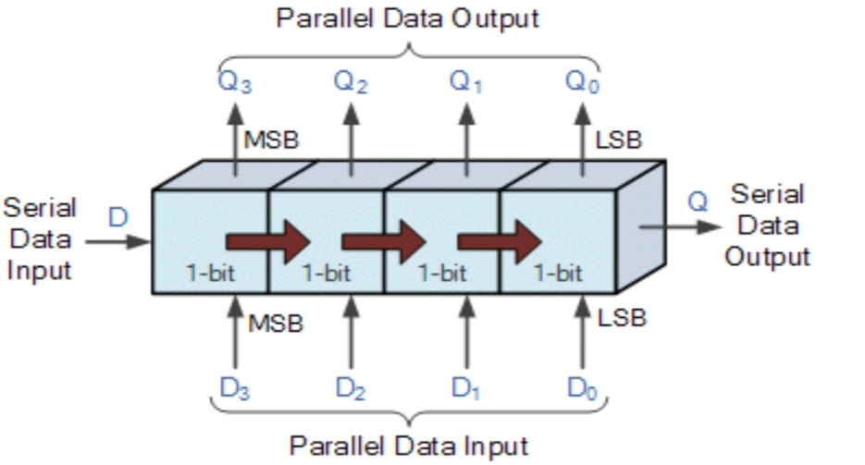
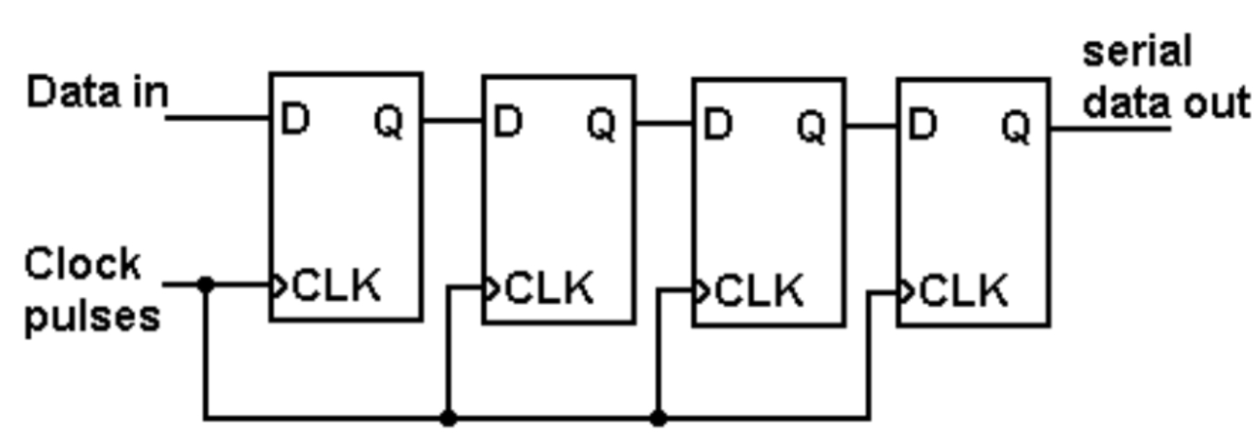
Shift Register
Shift register is designed by cascading the flip flops. The data from its inputs is placed into this sequential device, which then "shifts" it to its output once for every clock cycle, thus the name is Shift Register. The output of one flipflop becomes the input of the next, and so on.

Slide 8
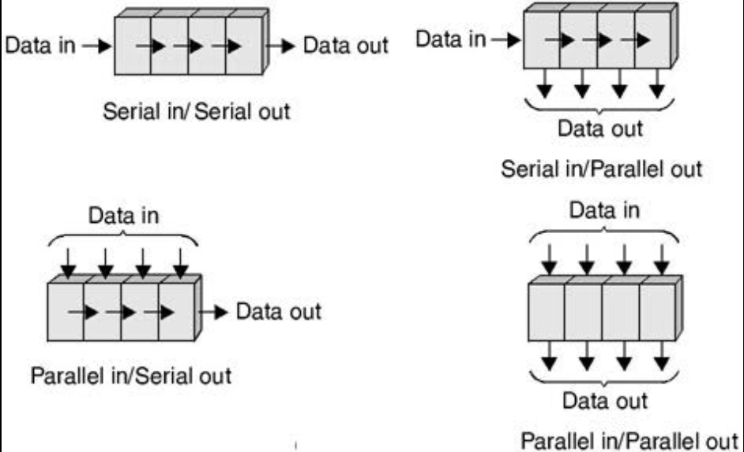
Following are the four types of shift registers based on applying inputs and accessing of outputs.

Slide 9
Proposed Methodology
The most common implementation of MTCMOS for reducing power makes use of sleep transistors.
Logic is supplied by a virtual power rail.
Low V_{th} devices are used in the logic where fast switching speed is important.
High V_{th} devices connecting the power rails and virtual power rails are turned on in active mode, off in sleep mode.
High V_{th} devices are used as sleep transistors to reduce static leakage power.

Slide 10
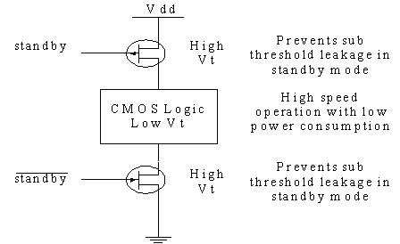
MTCMOS Technique
In CMOS technology with multiple thresholds (MTCMOS), an additional transistor is connected in series with the top and bottom tracks of the door
To reduce leakage, CMOS is structured with MTCMOS low, typical and high voltage transistors

Slide 11
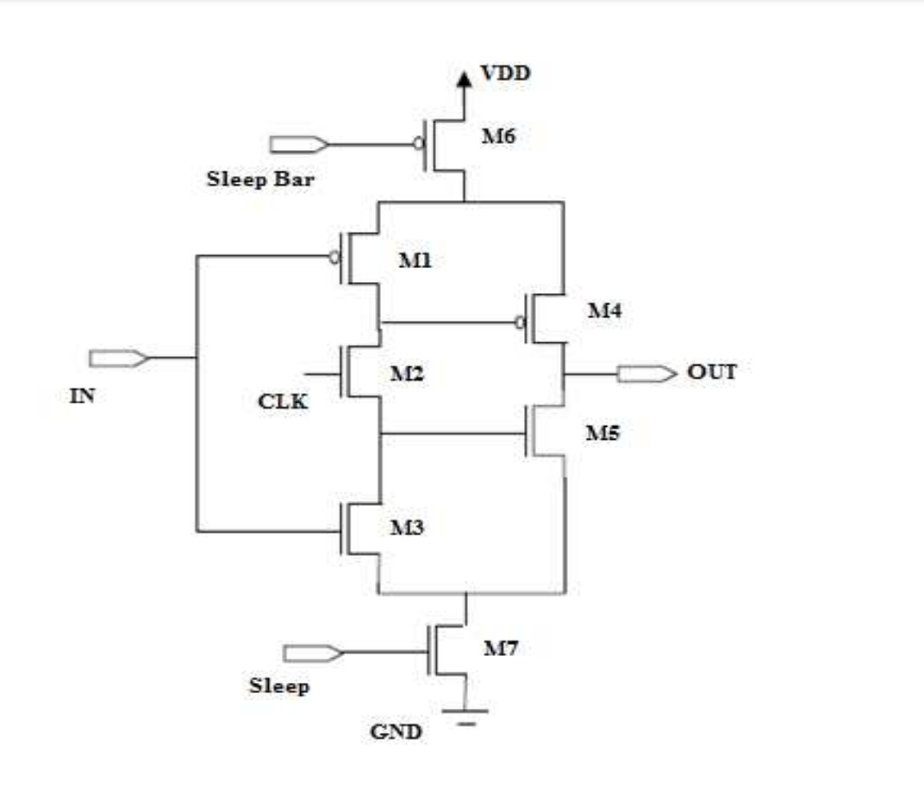

MTCMOS Based Shift Register

Slide 12
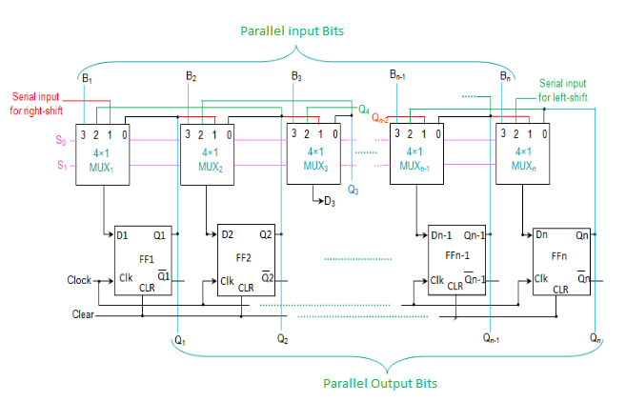
Universal Shift Register
The proposed MTCMOS based Flipflop can be used for the implementation of any of the shift registers and can also used for Universal shift registers.

Slide 13
Software Used
Digital Schematic Editor & Simulator
for Schematics
Microwind
for Layouts

Slide 14
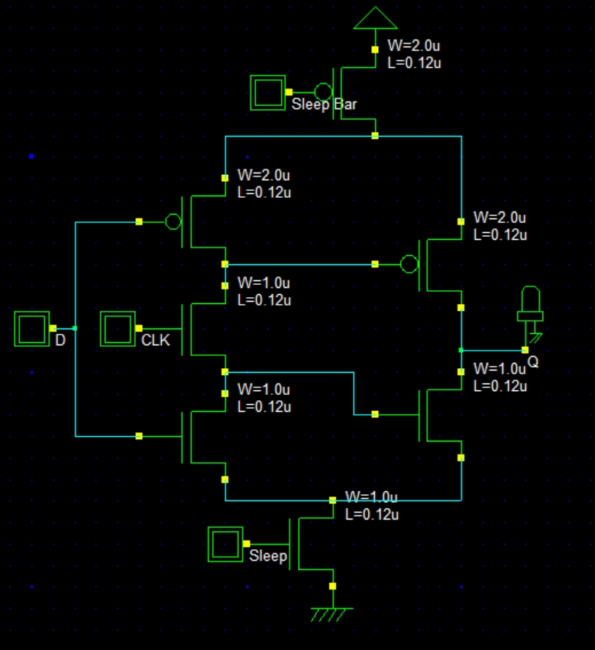
Schematic Diagrams
Figure: 5Transistor D Flipflop MTCMOS in DSCH

Slide 15
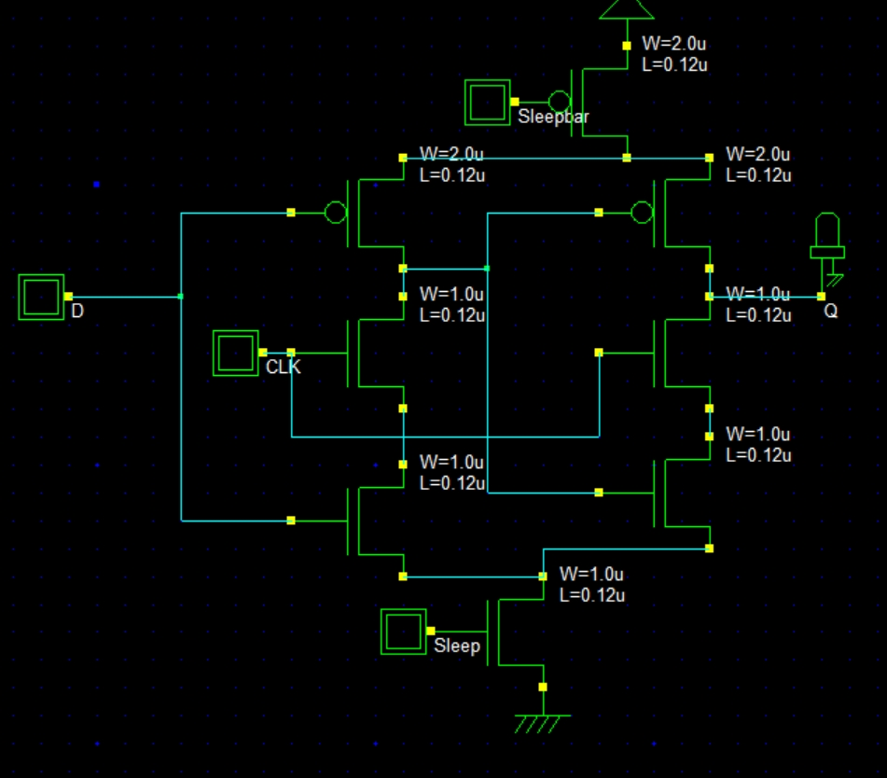
97
Figure: 6T-D Flipflop MTCMOS in DSCH

Slide 16
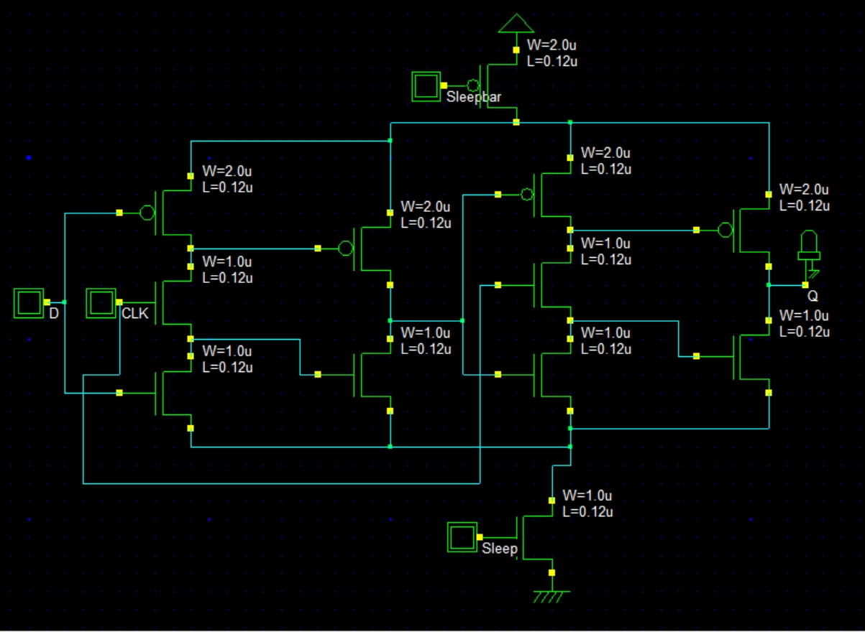
Figure: 10T-D Flipflop MTCMOS in DSCH

Slide 17
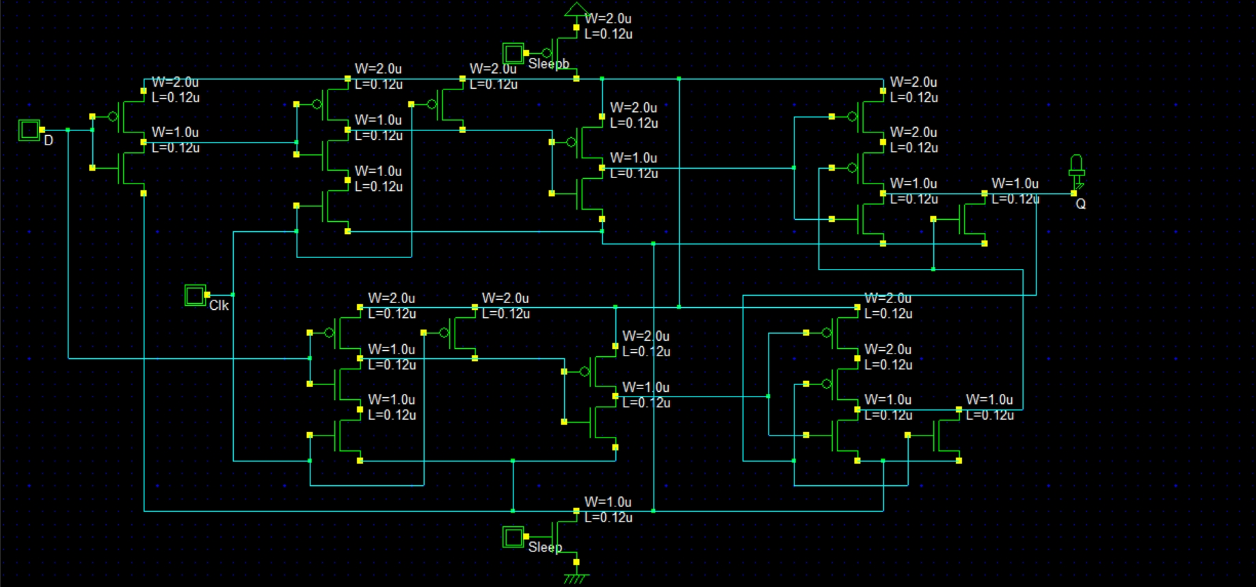
Figure: 22T-Flipflop MTCMOS in DSCH

Slide 18
Comparative analysis among various techniques
No. of Transistors | Power Consumption in μW
No. of Transistors | 0.18 µm (Technology) |  |  | 0.12 µm (Technology) |  |  | 90 nm (Technology)
 | 1.5 V | 1.2 V | 1.0 V | 1.5 V | 1.2 V | 1.0 V | 1.5 V | 1.2 V | 1.0 V
5 T - FF | 16.03 | 14.71 | 11.93 | 11.05 | 8.86 | 2.53 | 6.54 | 6.32 | 2.13
6 T – FF | 18.29 | 15.20 | 12.65 | 11.93 | 9.53 | 2.73 | 8.74 | 6.33 | 2.17
10 T – FF | 35.68 | 28.02 | 22.84 | 23.53 | 19.81 | 6.55 | 17.24 | 12.03 | 3.98
22 T - FF | 44.97 | 36.38 | 30.28 | 26.31 | 20.38 | 7.32 | 21.04 | 15.74 | 5.34
The power consumption of the circuit increases when we increase the number of transistors. When technology is scaled down, then the power consumption is decreased as shown in the above table.

Slide 19
Comparative analysis among various techniques )
No. of Transistors | Delay in nSec
No. of Transistors | 0.18 µm (Technology) |  |  | 0.12 µm (Technology) |  |  | 90 nm (Technology)
 | 1.5 V | 1.2 V | 1.0 V | 1.5 V | 1.2 V | 1.0 V | 1.5 V | 1.2 V | 1.0 V
5 T - FF | 3.02 | 2.98 | 2.88 | 2.67 | 2.29 | 1.77 | 1.23 | 0.96 | 0.83
6 T – FF | 3.67 | 3.43 | 3.21 | 3.02 | 2.66 | 2.13 | 2.00 | 1.46 | 0.99
10 T – FF | 4.23 | 4.00 | 3.89 | 3.69 | 3.56 | 3.29 | 3.18 | 2.67 | 1.87
12 T - FF | 5.13 | 4.98 | 4.56 | 4.36 | 4.21 | 4.06 | 3.95 | 3.18 | 2.67

Slide 20
Comparative analysis among various MTCMOS techniques
No. of Transistors | Power Consumption in μW
No. of Transistors | 0.18 µm (Technology) |  |  | 0.12 µm (Technology) |  |  | 90 nm (Technology)
 | 1.5 V | 1.2 V | 1.0 V | 1.5 V | 1.2 V | 1.0 V | 1.5 V | 1.2 V | 1.0 V
5 T – FF_ MTCMOS | 8.89 | 8.28 | 7.47 | 5.67 | 5.06 | 4.65 | 3.29 | 2.78 | 2.33
6 T – FF_ MTCMOS | 10.03 | 9.42 | 9.01 | 7.63 | 6.81 | 5.9 | 3.61 | 3.02 | 2.60
10 T – FF_ MTCMOS | 13.67 | 13.06 | 12.65 | 11.45 | 10.33 | 9.56 | 8.61 | 7.31 | 6.01
12 T – FF_ MTCMOS | 19.7 | 18.98 | 18.02 | 15.20 | 13.98 | 11.26 | 10.63 | 9.57 | 8.51
22 T –FF_ MTCMOS | 32.33 | 28.23 | 24.02 | 30.50 | 29.26 | 28.97 | 28.28 | 22.73 | 17.48

Slide 21
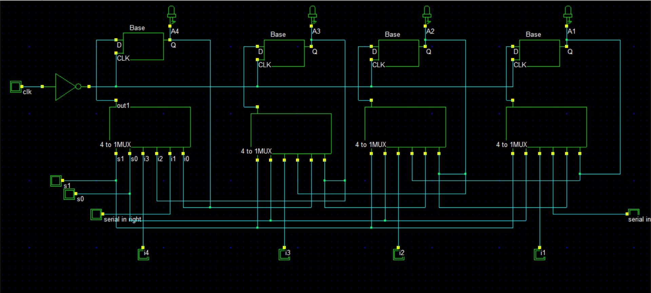
4-bit Universal Shift Register MTCMOS

Slide 22
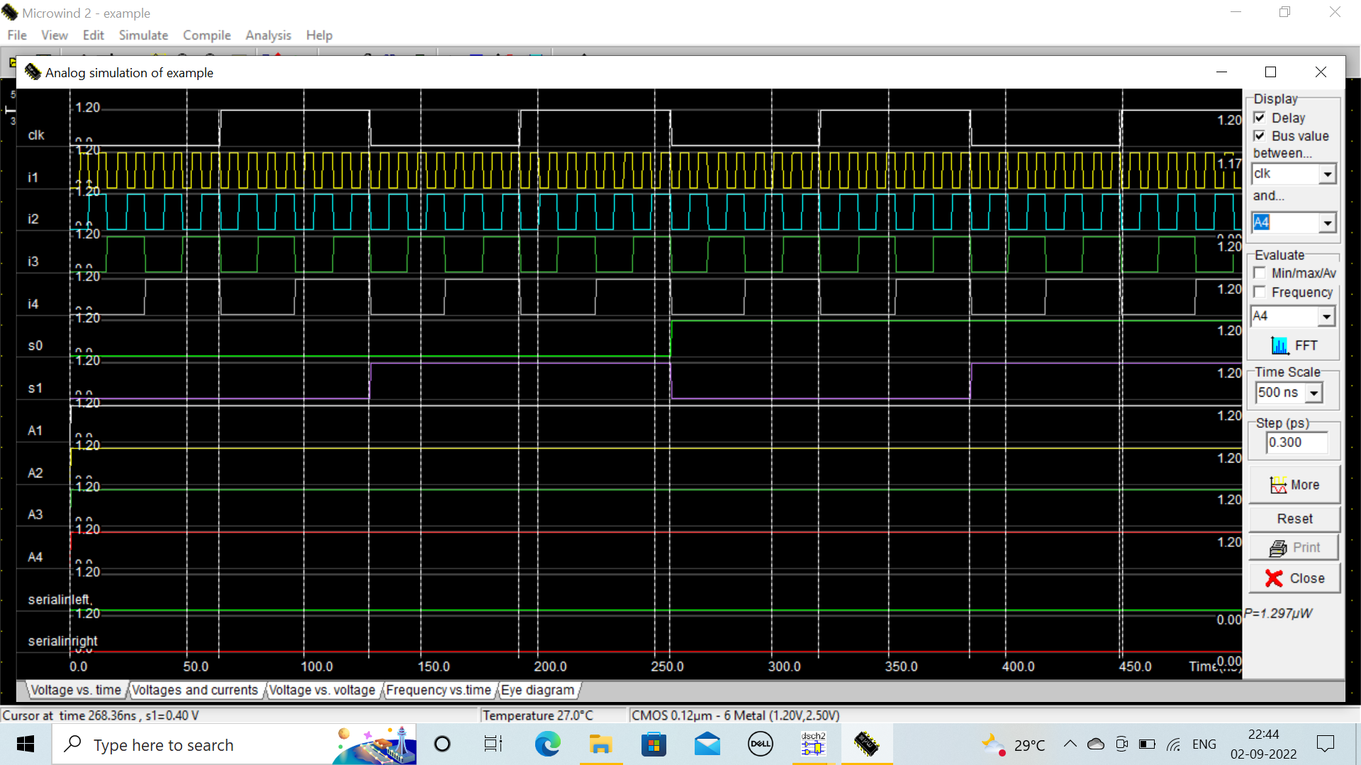
SIMULATION RESULTS
Figure: Power Consumption of 4-bit USR_MTCMOS

Slide 23
Conclusion
From simulation results, it is concluded that TSPC Flip-Flop is having less number of transistors with low power consumption when there is Technology Scaling and Voltage Scaling.
This is because it is having only 5 transistors (5T), only one transistor being clocked and that clock is having short pulse train.
By applying MTCMOS i.e., leakage power minimization technique, the leakage power is minimized when technology scales down.

Slide 24
Future Work
The project used in Microwind i.e., the technology is used to dedicate micro electronics and nano-technology for ASIC and Custom IC design and Simulation as well as the latest in electronic designs.
In the future we can increase the capacity of Shift Registers, Counters, Calculation of Power Dissipation can be implemented by the Standard Libraries and complicated circuits can be done by using CADENCE VIRTUOSO PLATFORM.

Slide 25
Thank You

